Slide 1
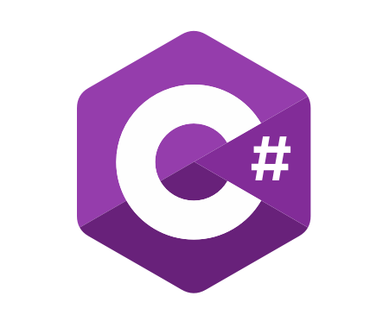
C# OOP
Course Introduction
SoftUni Team
Technical Trainers
Software University
https://softuni.bg/

Slide 2
Table of Contents
Course Objectives
Training and Team
Course Organization
Course Infrastructure
Evaluation Criteria

Slide 3
Have a Question?
sli.do
#csharp-advanced

Slide 4













SoftUni Diamond Partners

Slide 5

Course Objectives

Slide 6
Why OOP?
Object-oriented programming is an important paradigm
Anyone involved in software development should be familiar with OOP and Object-oriented modelling
All modern languages are either object-oriented or support classes and objects
Modern frameworks, libraries and APIs are object-oriented
OOP is a basic requirement for starting a job as developer
6

Slide 7
Practical Exam
2 practical problems for 4 hours:
Create a simple project that:
Follows the OOP principles
Implements functionality based on a description
Test a provided class
Automated judge system with real-time feedback
Upload a zip project to the judge system
7

Slide 8
Theoretical Exam
You will have 30 minutes once you enter
Multiple-choice with 1 or more correct answers
English
Automated quiz system
Available during the practical exam and 30 minutes after it
You can submit your answers just one time
Advice: Start it when you finish the practical exam
8

Slide 9

The Team

Slide 10
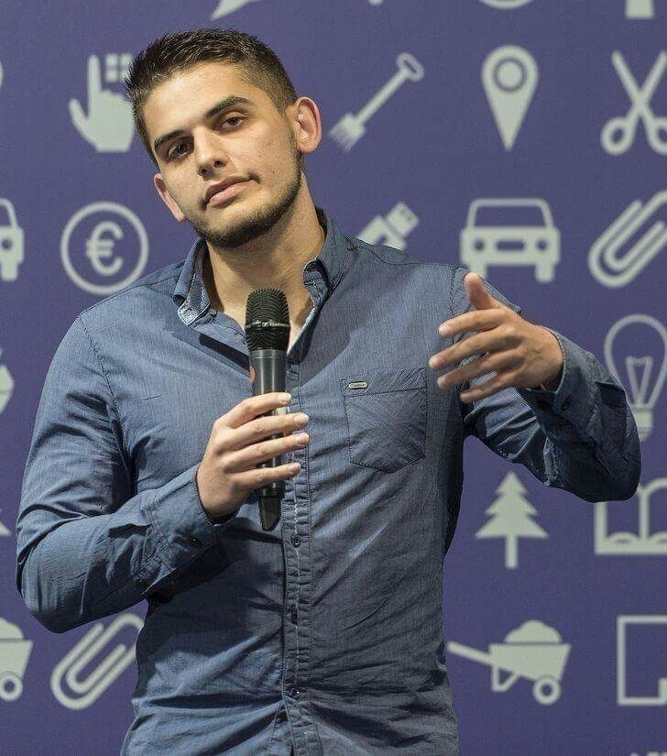
Viktor Dakov
Senior Developer SDE 3, Nuvolo
Worked at Amazon
John Atanasoff award
Participated in many programming contests
6+ Years of Experience as a Developer

Slide 11

Atanas Atanasov
.NET Software Engineer at Fourth
End-to-End Restaurant and Hospitality Software
Working with .NET and JavaScript(Angular || React)
Technical Trainer @ SoftUni
100+ training sessions
Interested in the vast world of algorithms

Slide 12

Course Organization

Slide 13
C# OOP Course – Timeline
23-Feb-2021
10-Apr-2021
18-Apr-2021
C# OOP
7 weeks * 4 times / week
15 credits
Start: 23-Feb-2021
Theoretical Exam: 10-Apr-2021
Practical Exam: 10-Apr-2021
Theoretical Exam Retake: 18-Apr-2021
Practical Exam Retake:18-Apr-2021

Slide 14

Homework Assignments & Exercises
Your homework is mainly work in class
Lesson days → slides + live demos + exercises
Exercise days → only exercises
How to submit your homework?
Submit in the judge system
Do your homework when it's due
Assignments pile up quickly

Slide 15


SoftUni Certificate
Practical Exam 100%
Homework 5%
Evaluation
15

Slide 16
CPE Certificate
Theoretical Exam 100%
Evaluation
16

Slide 17



Course Web Site, Forum and FB Group
Official web site:
Official discussion forum:
Community Facebook group:
https://softuni.bg/trainings/3210/csharp-advanced-january-2021
https://softuni.bg/forum/categories/15/csharp-oop-advanced
https://www.facebook.com/SoftUniCSharpCommunity/

Slide 18
Questions?
Notes:
18

Slide 19
Trainings @ Software University (SoftUni)
Software University – High-Quality Education, Profession and Job for Software Developers
softuni.bg, about.softuni.bg
Software University Foundation
softuni.foundation
Software University @ Facebook
facebook.com/SoftwareUniversity
Software University Forums
forum.softuni.bg
19
Notes:
19

Slide 20

License
This course (slides, examples, demos, exercises, homework, documents, videos and other assets) is copyrighted content
Unauthorized copy, reproduction or use is illegal
© SoftUni – https://about.softuni.bg
© Software University – https://softuni.bg
Notes:
20

